Slide 1



Predictive Maintenance for Industrial Equipment
Team Members
211701035-NANDAKUMARAN M
211701043-RAMKISHORE S

Slide 2

Problem Statement
Build a predictive maintenance model to forecast equipment failures using sensor data, aiming to reduce downtime and maintenance costs.
Use the "Predictive Maintenance Dataset" with machine operational settings, sensor measurements, and historical failure events.
Clean the data, handle missing values, engineer features, and normalize the sensor data for analysis.
Evaluate machine learning models such as Random Forest Classifier, Logistic Regression, and SVM for optimizing through hyperparameter tuning and cross-validation.
Extract insights from the model to develop predictive maintenance schedules and strategies to improve equipment reliability and reduce costs.

Slide 3

Dataset Source and Structure
Dataset Source
No of Features | 10 columns
No of Records | 10,000 rows

Slide 4
Dataset Feature Description
• UDI : Unique identifier for each record, ensuring traceability
• Product ID : A categorical identifier representing the specific product or machine.
• Type : Category of product, which can impact operational characteristics. (M,L and H)
• Air Temperature [K] : Ambient air temperature, measured in Kelvin, influencing operational conditions.
• Process Temperature [K] : Internal process temperature in Kelvin, key for understanding internal heating dynamics.

Slide 5
Dataset Feature Description
• Rotational Speed [rpm] : Speed of the equipment’s rotation in revolutions per minute, reflecting workload levels.
• Torque [Nm] : Torque applied, measured in Newton meters.
• Tool Wear [min] : Time (in minutes) of tool usage, indicating wear over time.
• Target: Binary indicator if there’s a failure (1) or not (0).
• Failure Type : Specifies failure category (No Failure, Power Failure, Tool wear Failure, Overstrain Failure, Random Failure and Heat Dissipation Failure)

Slide 6

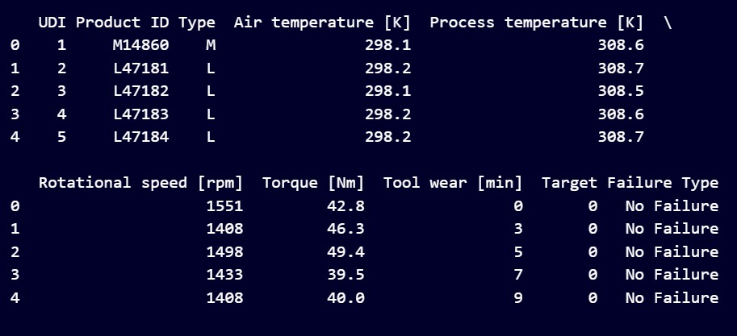

Data Acquisition and Cleaning
CODE
df_new = pd.read_csv('predictive_maintenance.csv')
print(df_new.head())
if missing_values.sum() > 0:
print("Missing values detected. Filling missing values...")
for col in df_new.select_dtypes(include=['number']).columns:
df_new[col].fillna(df_new[col].mean(), inplace=True)
for col in df_new.select_dtypes(exclude=['number']).columns:
if not df_new[col].mode().empty:
df_new[col].fillna(df_new[col].mode()[0], inplace=True)
else:
df_new[col].fillna("Unknown", inplace=True)
print("Missing values handled successfully.")
else:
print("No missing values detected.")
OUTPUT

Slide 7

Data Acquisition and Cleaning
CODE
duplicates = df_new.duplicated()
if duplicates.sum() > 0:
print(f"{duplicates.sum()} duplicate rows detected. Removing duplicates...")
df_new.drop_duplicates(inplace=True)
print("Duplicates removed successfully.")
else:
print("No duplicate rows detected.")
OUTPUT

Slide 8

Data Preprocessing
CODE AND OUTPUT
df_new['temp_diff'] = df_new['Process temperature [K]'] - df_new['Air temperature [K]’]
df_new['torque_speed_interaction'] = df_new['Torque [Nm]'] * df_new['Rotational speed [rpm]’]
# Selecting columns to be normalized
sensor_columns = ['Air temperature [K]', 'Process temperature [K]','Rotational speed [rpm]', 'Torque [Nm]', 'Tool wear [min]', 'temp_diff', 'torque_speed_interaction’]
EXPLANATION
Which captures the difference between "Process temperature [K]" and "Air temperature [K]".
This transformation highlights the temperature gradient, which could influence the system's behavior or failure rates.
Which captures the interaction feature, torque_speed_interaction, by multiplying "Torque [Nm]" and "Rotational speed [rpm]".
This feature represents the combined effect of torque and rotational speed, which could directly correlate with the machine’s Stress

Slide 9
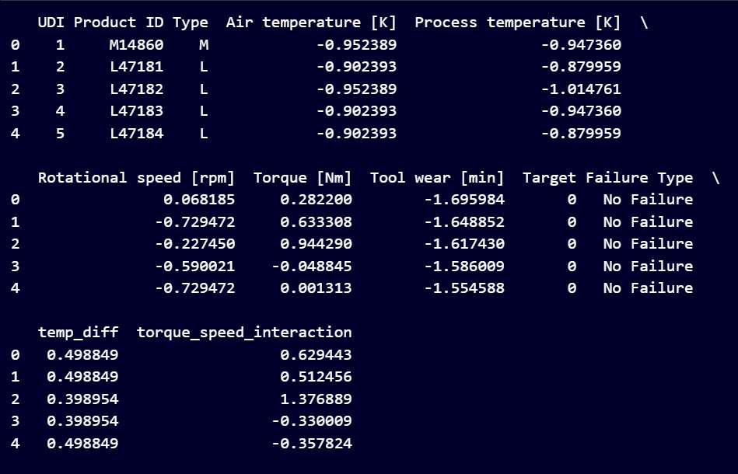
Data Preprocessing
CODE AND OUTPUT
scaler = StandardScaler()
df_new[sensor_columns] = scaler.fit_transform(df_new[sensor_columns])
print(df_new.head())
EXPLANATION
Normalization standardizes data to have a mean of 0 and a standard deviation of 1, ensuring all features contribute equally to the model's learning process.
Selected features are transformed using StandardScaler, which subtracts the mean and scales by the standard deviation, creating a uniform scale across all variables.

Slide 10

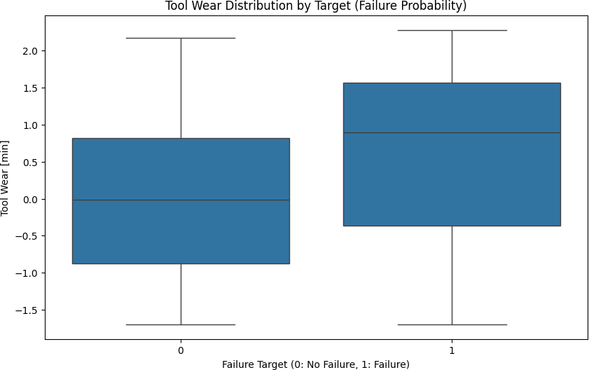
Tool Wear and Failure Probability
Inference : The box plot reveals variations in Tool wear [min] across failure targets (Target).
Observation : Higher Tool wear often correlates with increased failure probabilities, as indicated by distinct distributions in the box plot.
Recommendation : Regular monitoring of Tool wear levels in equipment could prevent unexpected failures.

Slide 11
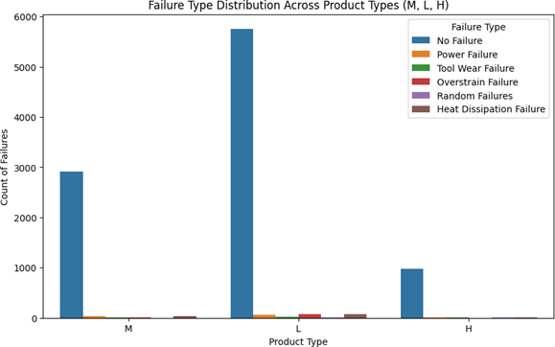
Failure Type vs. Product Type
Inference : The count plot illustrates the frequency of different Failure Types, highlighting which failure types are most common.
Observation : Certain failure types, such as tool wear, occur more frequently than others.
Recommendation : Allocate resources to address the most frequent failure types for cost- effective maintenance.

Slide 12
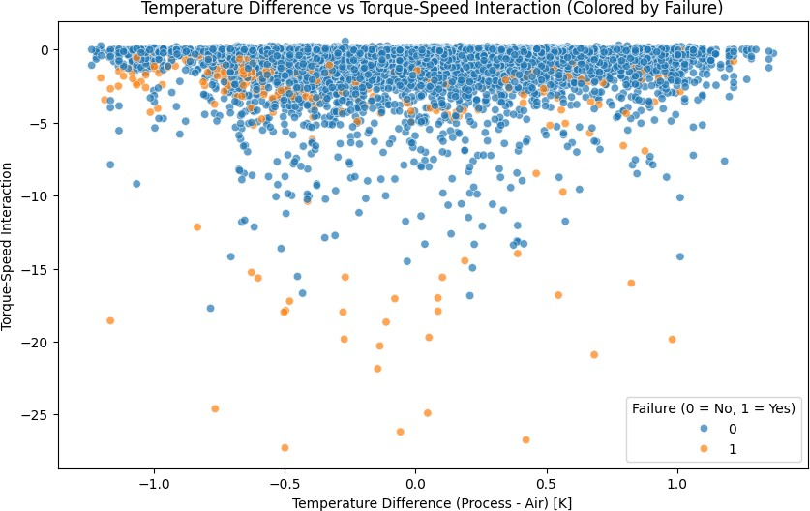
Temperature Difference Vs Torque-Speed Interaction
Inference : The scatter plot displays the relationship between temp_diff and torque_speed_interaction, indicating potential clusters based on the failure target.
Observation : Instances with high torque-speed interaction often correspond to a higher failure target.
Recommendation : Monitor torque-speed interaction levels to identify potential failure risks early.

Slide 13
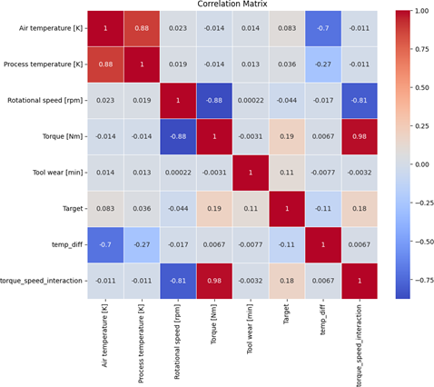
Correlation Matrix For Different Numerical Features
Inference : The heatmap reveals the correlations between different numerical features, showing both positive and negative relationships.
Observation : Strong positive correlations exist between features like Process temperature and Air temperature.
Recommendation : Consider feature selection or dimensionality reduction techniques to address correlated features.

Slide 14

Machine Learning Model
Random Forest Classifier :
This ensemble model is ideal for datasets with potentially complex, non-linear relationships.
Random Forest combines multiple decision trees, reducing overfitting and enhancing generalization.
It works well for tabular datasets with a mix of numerical and categorical data. It can also handle imbalanced datasets well, which is likely in failure prediction (more "No Failure" cases than "Failure").

Slide 15
Machine Learning Model
Logistic Regression :
Serving as a baseline model, Logistic Regression is simple and interpretable, making it a straightforward approach to binary classification tasks.
Adjusting the regularization strength parameter to improve model accuracy and control for potential overfitting.
A simpler model, effective for binary classification tasks like "failure/no failure." If interpretability is important, logistic regression provides a straightforward interpretation of feature coefficients.

Slide 16

Machine Learning Model
Support Vector Machine (SVM) :
SVM excels in binary classification tasks, particularly when a clear margin of separation exists between classes.
Kernel functions enable SVM to model non-linear relationships, making it effective for identifying distinct failure patterns in operational data.
SVM's robustness in high-dimensional spaces allows it to work effectively with complex datasets containing numerous features.

Slide 17
Model Evaluation
The Random Forest model achieved high accuracy, reflecting its capability to capture complex patterns in the data. Its AUC-ROC score was strong.
Logistic Regression showed good accuracy but slightly lower performance on recall compared to Random Forest it may miss some failure cases.

Slide 18
Summary of the Findings
Improved dataset integrity through comprehensive cleaning and preprocessing by addressing missing values, duplicates, and inconsistencies.
Identified critical factors, such as sensor readings and operational conditions, that significantly impact equipment performance and maintenance needs.
Utilized advanced machine learning algorithms (Random Forest, Logistic Regression, SVM) with hyperparameter tuning to achieve high accuracy and reliability in forecasting equipment failures.
Minimized unplanned downtime, optimized resource utilization, and reduced maintenance costs, showcasing the model's transformative potential for industrial maintenance strategies.

Slide 19
Thanks!
Any questions ?

